Slide 1
Environmental conservation
Environmental conservation is the protection, preservation, management, or restoration of
natural environments and the ecological communities that inhabit them. It refers to all practices that pave the way for protecting the environment and natural resources on the individual,
organizational as well as governmental levels. Conservation is generally held to include the
management of human use of natural resources for current public benefit and sustainable social and economic utilization.
Environmental management and conservation recommendations
recommends the following ways or strategies to facilitate and promote environmental management and conservation for sustainable social and economic development.
Strategy 1: Conduct environment management and protection research/studies
Create awareness on environmental issues by describing the interdependence relationship between environment and social-economic issues
Designing and conducting researches/studies intended to explore environmental issues
Developing environment workshops and forums for discussing environmental issues Developing and conducting environmental campaigns.

Slide 2
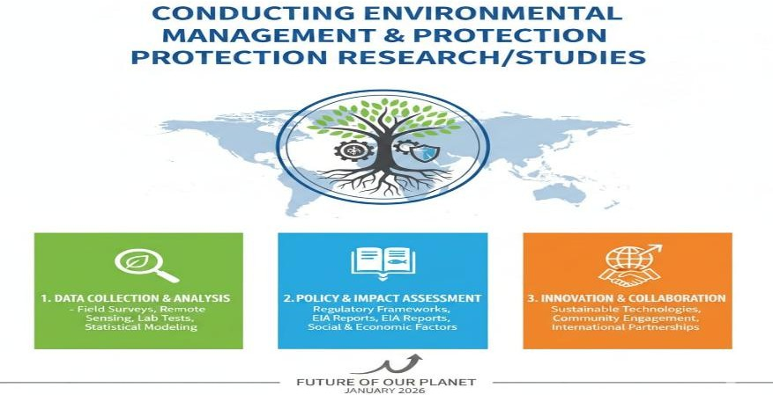
Strategy 2: Provision of consultancy services in environmental management and assessment
Promote best practices in environmental management through provision of environmental management and assessment consultancy services

Slide 3
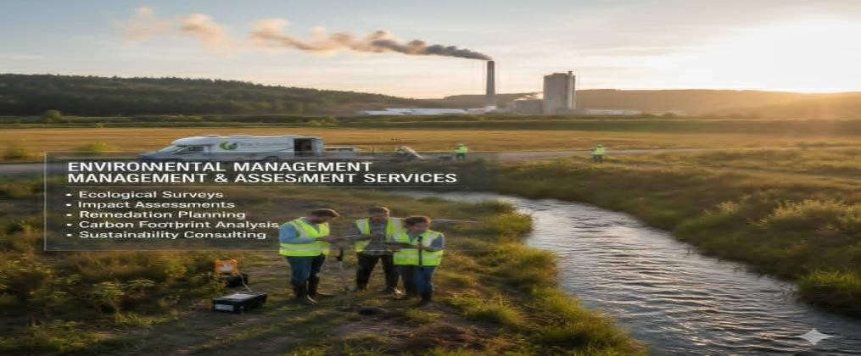
Strategy #3: Promote and facilitate environment conservation through innovation of environmental protection initiatives
Helps the community to understand the fragility of the environment and the importance of its protection for sustainable social and economic development.
Designing and implementing projects aiming at increasing community awareness on environmental issues

Slide 4
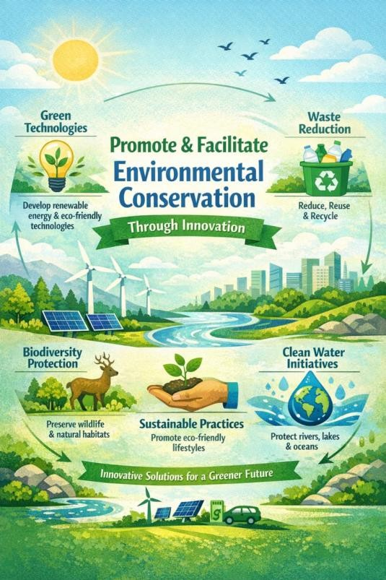
Promoting partnership in environment conservation projects and designing as well as the implementation of environmental campaigns is currently developing and conducting
environmental campaigns.

